Slide 1
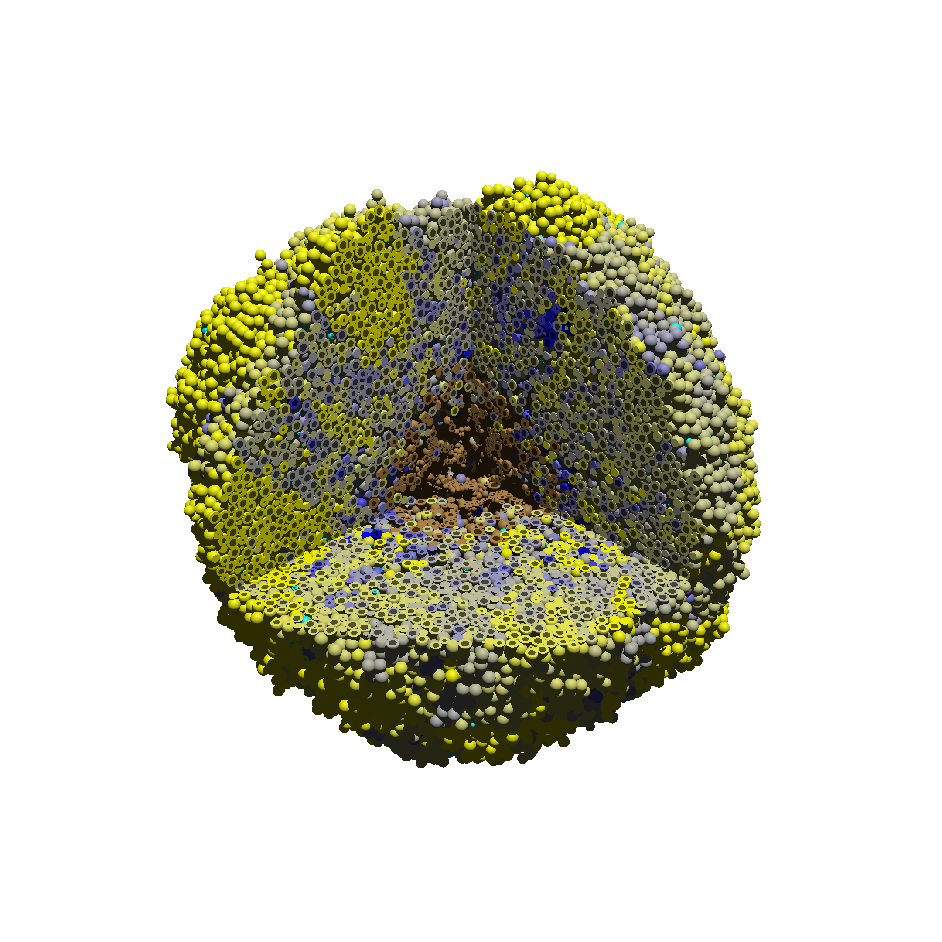
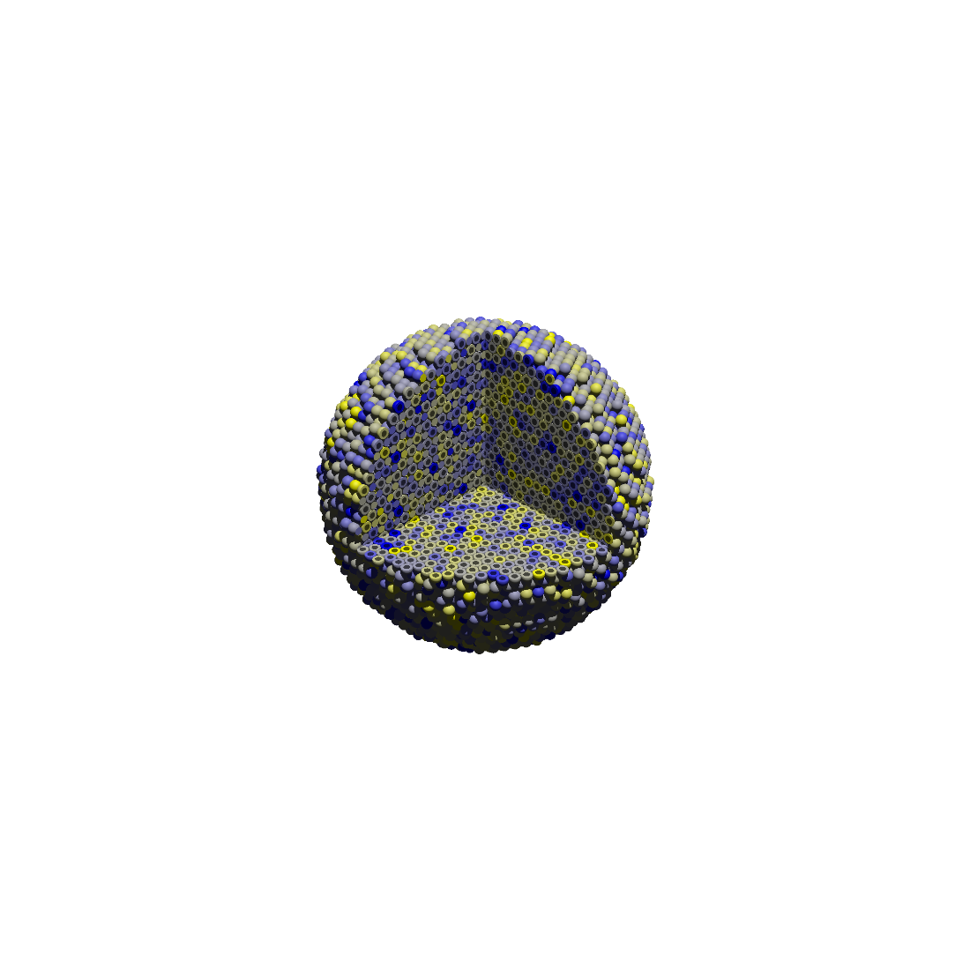
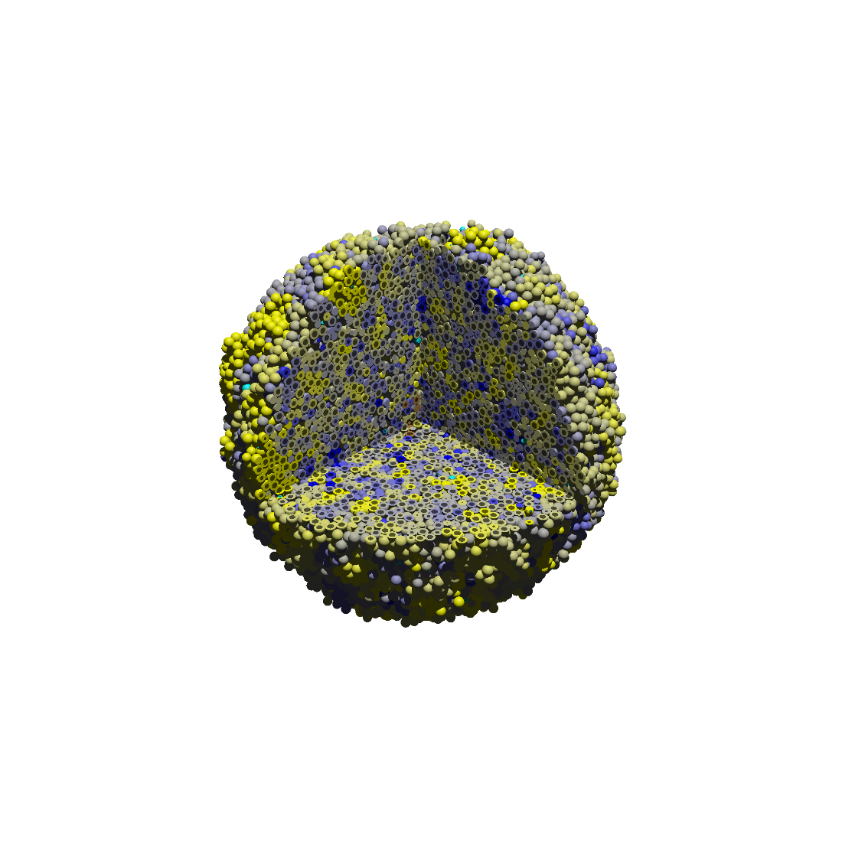
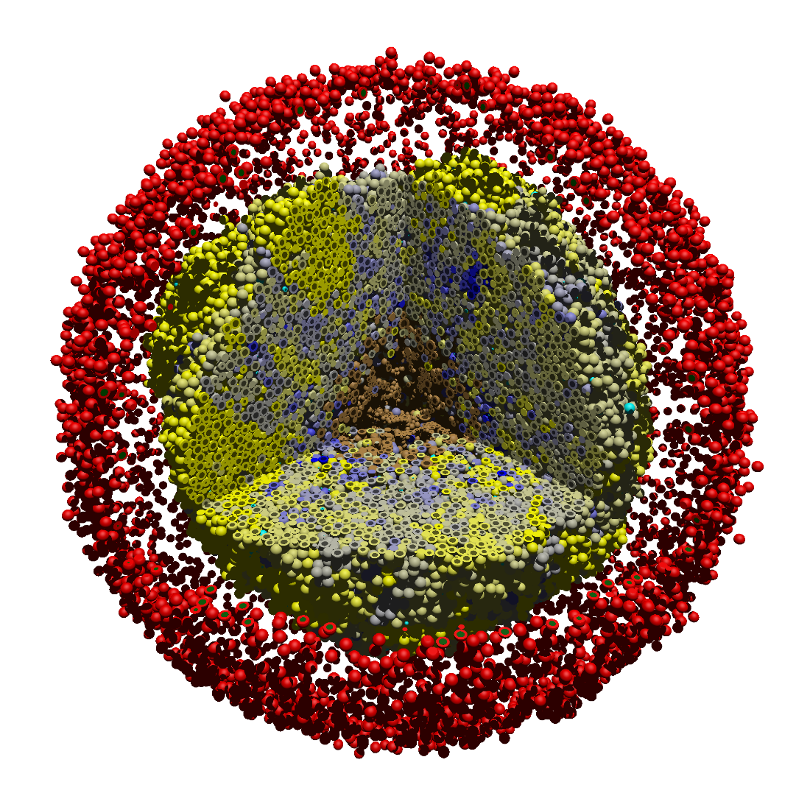
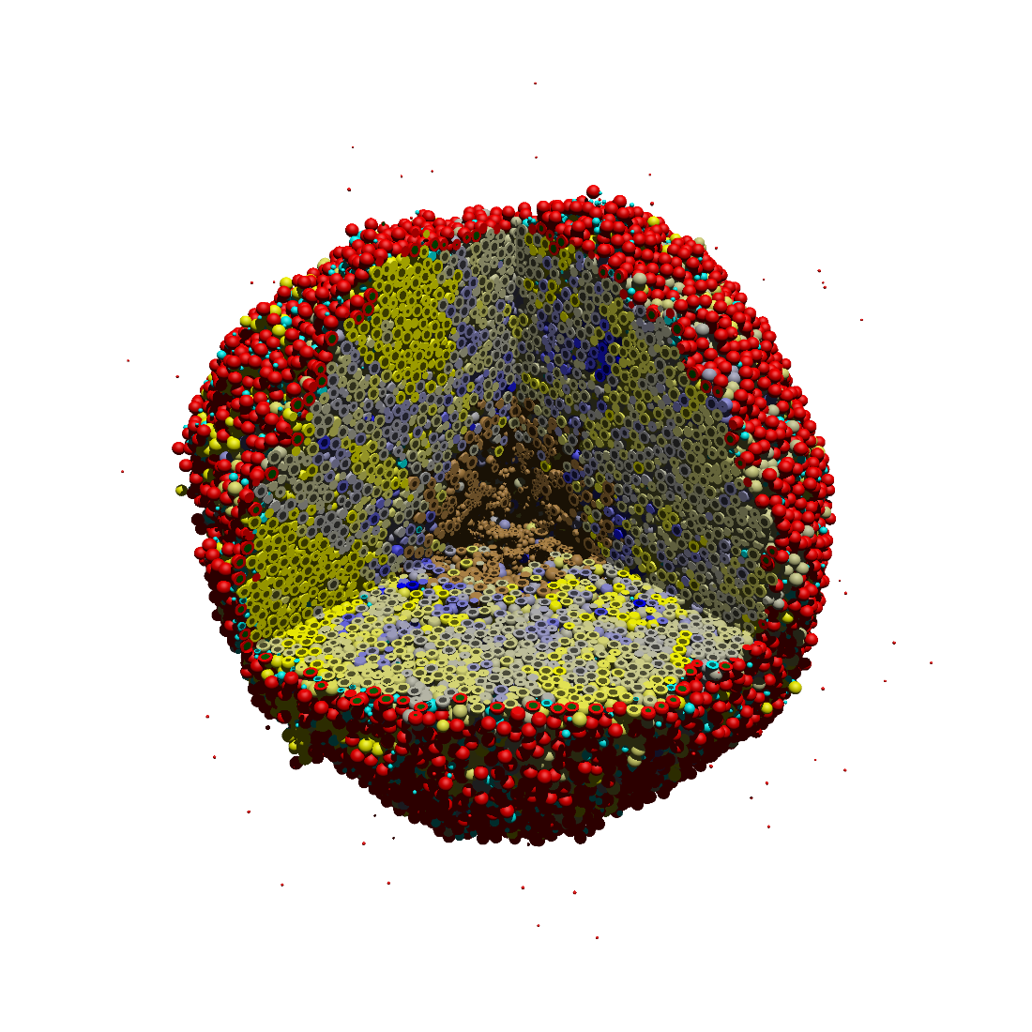
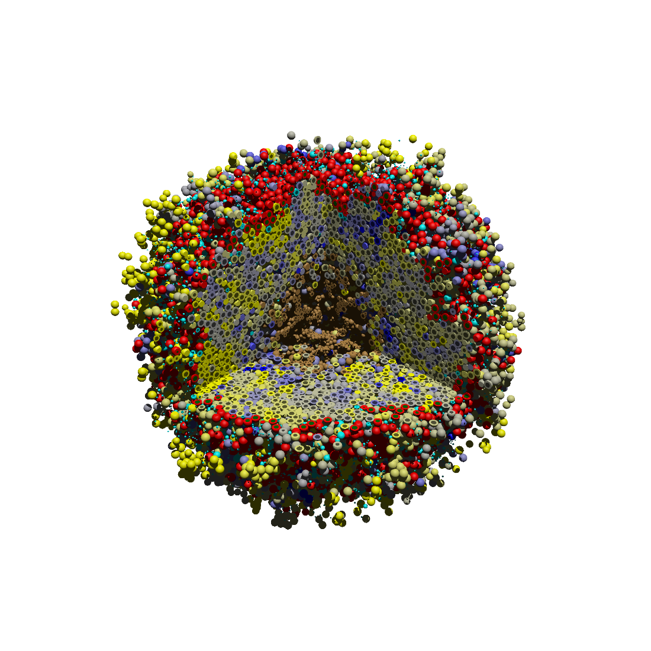
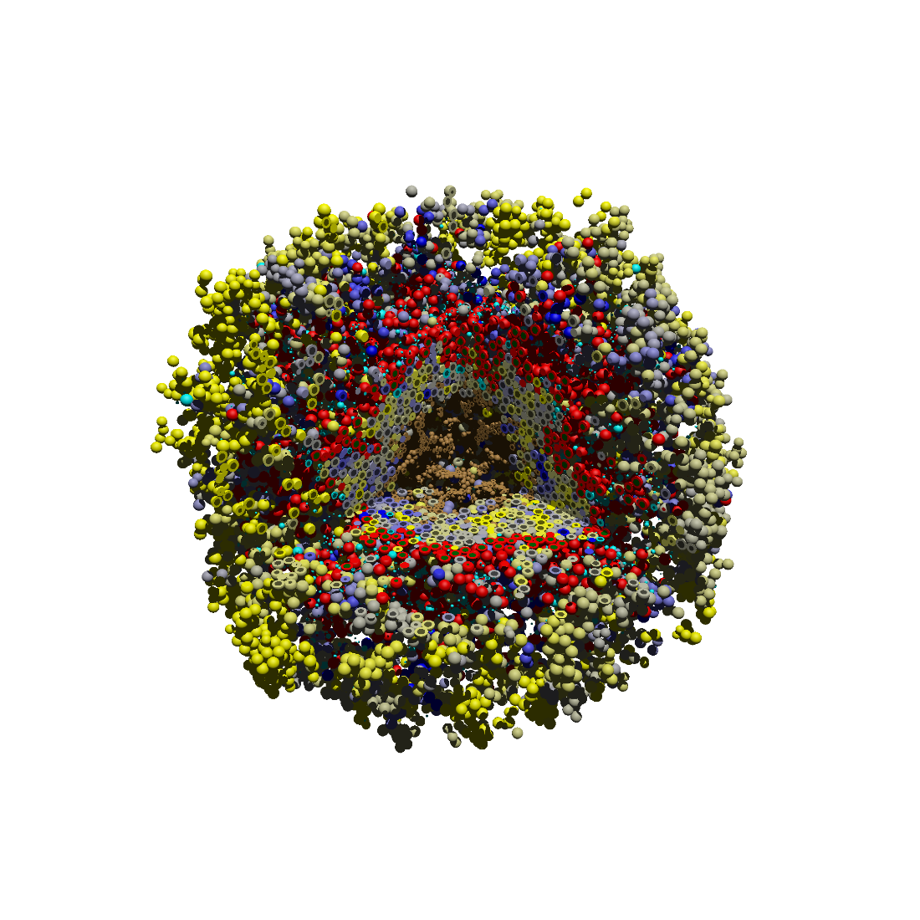
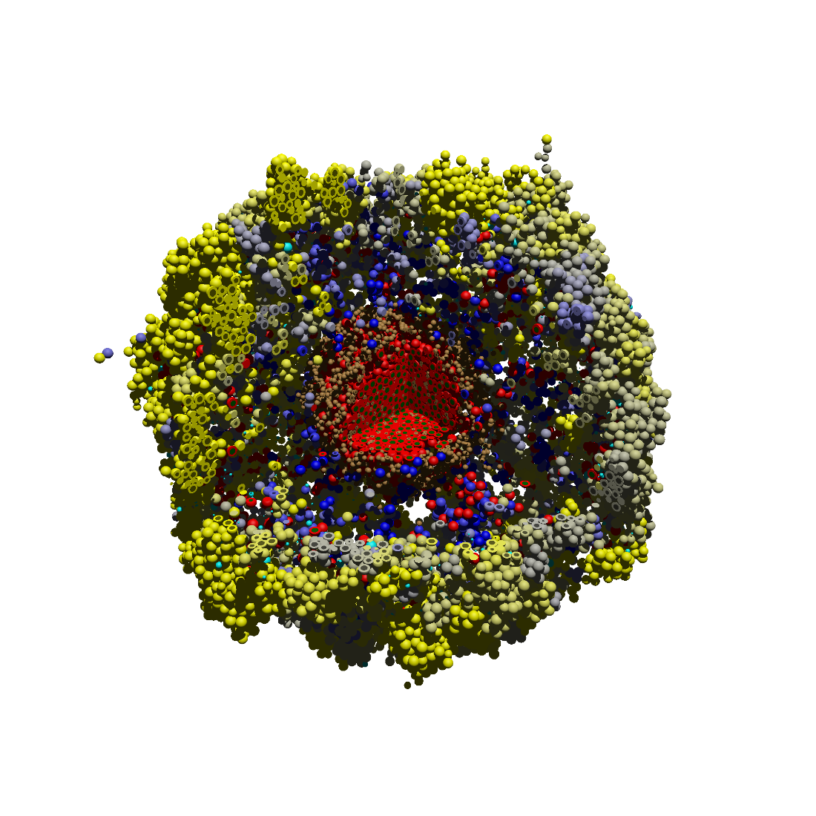
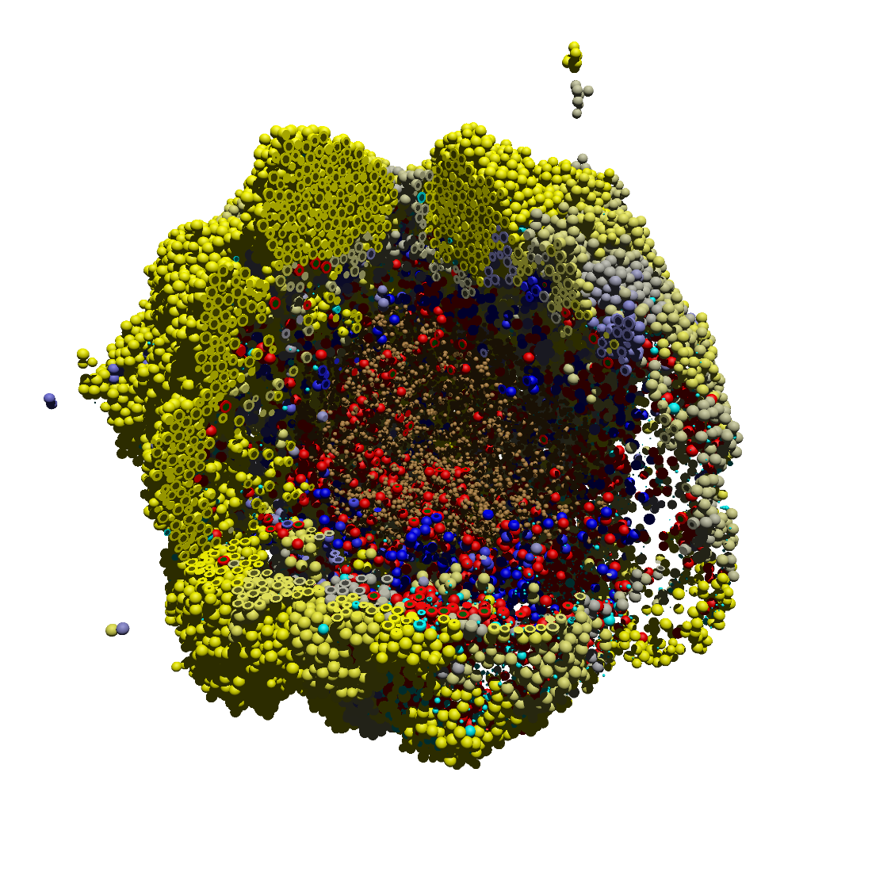
0 days
18,317 cells
7 days
53,600 cells
14 days + 3 min
111,479 cells
14 days + 6 hours
113,668 cells
15 days
91,189 cells
16 days
51,788 cells
18 days
38,122 cells
21 days
66,978 cells
Notes:
Times: Counts:
0 18317
7 days 53600
14 days 103944
14 days, 3 min 111479
14 days + ? Hours
15 days 91189
16 days 51788
18 days 38122
21 days 66978
Counts:
18317
Activate immune at 14 days, run to 21
0, 14, 14*
+6 hours,
+1 day
0, 14d, 14d*, +6h
+1d +2d +4d +1w
0, 14d, 14d*, 14d+6h
15d, 16d, 18d, 21d
0, 7, 14d*, 14d+6h
15d, 16d, 18d, 21d
6
24
48
96

